Slide 1
Cyber Crimes, Forensics and Incident Handling
Amit Dua

Slide 2
Learning Outcomes
LO1 | Fundamental understanding and Information on Cyber Crimes, Digital Forensics Objectives and Incident Detection and Response Reports.
LO2 | Learn on how to prepare investigation on computer-related incidents or crimes and summarize.
LO3 | Understand on digital forensics process, models and analysis by taking a systematic approach
LO4 | Explore on evaluating needs, validating and testing digital forensics tools, Generating Incident Report Findings, and Emerging Cybercrime Trends and Issues

Slide 3
Course objectives
CO1 | Enhancing awareness of recent Cyber Crime trends and learn Investigating Cyber Crimes
CO2 | Introduce Cyberspace Infrastructure attacks and handling Organization Cybersecurity Issues
CO3 | Understand Digital Forensics Process, Models, Analysis and Validation, Incident Detection and Response

Slide 4
Text Book(s)
T1 | Computer Forensics and Cyber Crime - An Introduction 3rd Edition by Marjie T. Britz, Ph.D., Professor of Criminal Justice, Clemson University
T2 | Bill Nelson, A. Philips, F. Enfinger, C. K. Steuart, Computer Forensics and Investigations, Course Technology (Cengage Learning), Indian edition, 2009
T3 | Incident Response & Computer Forensics, 3rd Edition by Jason T. Luttgens and Matthew Pepe and Kevin Mandia
R1 | Guide to Computer Forensics and Investigations: Processing Digital Evidence 5th Edition by Bill Nelson, Amelia Phillips and Christopher Steuart
R2 | The Basics of Digital Forensics, by John Sammons
R3 | Computer Network Security and Cyber Ethics 4th Edition, by Joseph Migga Kizza
R4 | Computer Forensics_ Investigating Network Intrusions and Cyber Crime: EC-Council Press

Slide 5
Expectations from the course
Understand Psychology
Saving lives and finances
Secondary income
Digital forensics– sky is the limit

Slide 6
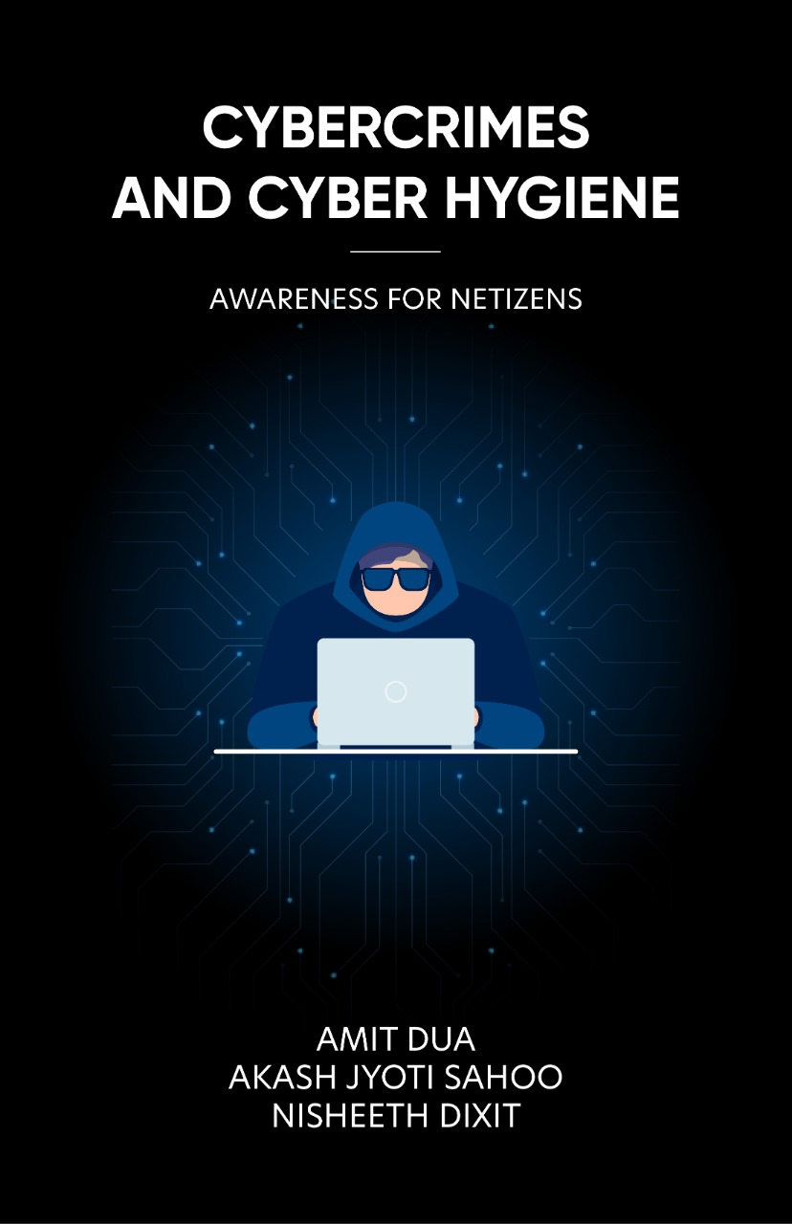
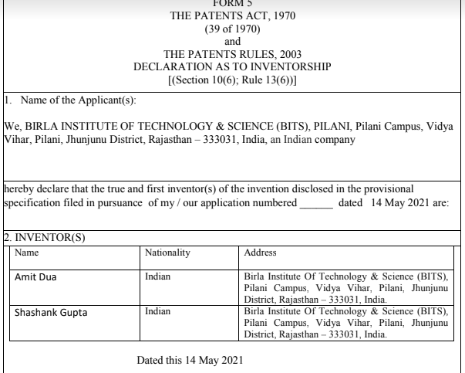
Amit Dua

Slide 7
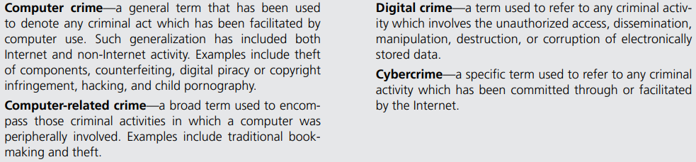
Definitions

Slide 8
Forensic science
computer forensic science, computer forensics, and digital forensics may be defined as the methodological, scientific, and legally sound process of examining computer media and networks for the identification, extraction, authentication, examination, interpretation, preservation, and analysis of evidence.

Slide 9
Traditional Problems Associated with Computer Crime
Physicality and Jurisdictional Concerns
Perceived Insignificance, Stereotypes, and Incompetence
Prosecutorial Reluctance
Lack of Reporting
Lack of Resources
Jurisprudential Inconsistency
Extent of the Problem

Slide 10
The Emergence of e-Cash: A New Problem for Law Enforcement
Prepaid Cards
Stored Value Cards
Mobile Payments
Internet Payment Services
Digital Precious Metals

Slide 11
challenges that technologies face in cybersecurity
Supply chain interconnection
Hacking
Phishing
Lack of uniformity in devices used for internet access
Lack of awareness

Slide 12
Case
Rahul received a whatsapp forward with a link to a lucky draw game.
What happened here?
What could he have done here to prevent the crime?

Slide 13
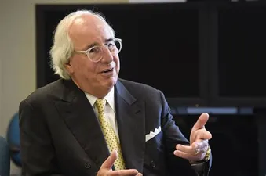
“Every case involving cybercrime that I’ve been involved in, I’ve never found a master criminal sitting somewhere in any country. It always ends up that somebody at the company did something they weren’t supposed to do. They read an email, went to a website they weren’t supposed to.“
- Frank Abagnale

Slide 14
Types of Cybercrime
Phishing:
Hacking:
Smishing:
Vishing:
Identity theft:
Cyber stalking:
Ransomware attacks:
Through malware:
VOIP:

Slide 15
Deepfake:
Web Jacking:
Data diddling:
Denial of services (DoS):
Drive by download attack
Watering hole attack:
Tailgating:
Juice Jacking:
Business Email Communication scams:
Whaling attack:
Using Digital voice assistants:

Slide 16
Different cyber crimes
Debit card cloning

Slide 17
What we should do
Make sure you never give your ATM card and pin number to anyone, no matter how close they are to you. Not even your closest relatives and family members.
Check for extra layering in the area where you insert your card for skimmers.
Also cover the keyboard while entering the pin because there may be suspicious cameras lying around tracking the keys you enter.
Never share your card details, CVV number and OTP number with anyone over call or in person.
If you ever receive an OTP for any transaction which you did not initiate, then you should immediately get your credit card and debit card blocked as it is possible that someone has made an attempt to steal your money.

Slide 18
RBI Guidelines
If a third party was involved and took your money without your knowledge, then the bank is liable to pay you the exact amount that you have lost. If some sort of skimmer device was installed into the ATM because of which your card got cloned without your knowledge, then it is not your liability and the bank has to pay back your amount.

Slide 19
Cont.
2. If you lost your money due to some security flaw of the bank, or if your account got hacked, then the bank will have to pay the amount that you have lost.
3. Finally if the user has lost his money from his account because of a mistake on his part (shared his OTP orpasswords with another person) then the bank will not pay back the amount because it was entirely the person’s fault.

Slide 20
IT Act
IT Act Section 66 for Computer Related offences,
IT Act Section 66C for punishment for identity theft.
IT Act Section 66D for punishment for cheating by personation using a computer resource.
IPC Section 419 for punishment for cheating by personation.
IPC Section 420 for cheating.
IPC Section 468 for forgery.

Slide 21
What made me here?

Slide 22
What is your commitment for this course

Slide 23
5 things to achieve
Mental strength
Physical strength
Do one Challenge early
Proximity is power
Giving is actual living

Slide 24
Questions
How can the intangibility of computer crime complicate investigations
and subsequent prosecutions?

Slide 25
How has computer crime been characterized in the past? Do these
perceptions hinder investigations? How?

Slide 26
Why are individual victims reluctant to report computer crime?
What about private corporations?

Slide 27
What are some of the general costs associated with the investigation
of computer crime? How do these compare with traditional
investigations? What suggestions can you offer to increase the
resources available for such?

Slide 28
Discuss the problems associated with the limited resources available
in most police departments across the country. What can be
done to alleviate some of these problems?
What is meant by jurisprudential inconsistency?

Slide 29
No. | Title of the Module
M1 | Introduction to Cyber Crime, Digital Forensics and Incident Handling
M2 | Foundation for Forensics
M3 | Computer Crime and Identity Theft/Fraud
M4 | Digital Forensic Process, Analysis and Validation
M5 | Disk Structures (File Systems) and Data-hiding techniques
M6 | Network and Cloud Forensics; Mobile Device and Security
M7 | Digital Forensic Tools and Labs
M8 | Organizations and Cyber Crime, Criminology and Organized Crime
M9 | Investigating Internet Crime and E-Mail Crime
M10 | Cyberspace Infrastructure and Enterprise Security
M11 | Incident Detection and Characterization
M12 | Incident Response and software Tools
M13 | Incident Report Writing
M14 | Emerging Cybercrime Trends, Recommendations and Practical Issues
M15 | Miscellaneous Topics

Slide 30
Thank You!
Next chapter:
Foundation for forensics

